Slide 1

Data Storytelling and Visualization
Gaurang Sharma (11012446)
Chinmoy Sarangi (11012375)

Slide 2
The Dataset
New York City Taxi Trips for Green taxis in December 2015
Domain: City Transport
Prior Exploration: There have been many aspects that have been explored for this dataset, so we attempted to identify some novel ideas.

Slide 3
The Dataset (contd.)
Dataset did not need cleaning.
There were additional dimensions added for performing analysis to answer the business questions.
Data was stored in a SQL database for efficient handling.

Slide 4
Business Questions answered by Visualizations (Tableau)
What locations have max pickup and drop-off volume?
What day is the busiest day of the week?
What areas fetch highest tips for pickup and drop-offs?
Novel Idea: What days and/or hours are best for repair and maintenance work for civic authorities in New York City?

Slide 5
Business Questions answered by Visualizations (Power BI)
Novelty: Indicate on Maps where the Taxi trip was picked up from and where it was dropped. Also showing the Time and the Day of the trip.
Show Pick-Up & Drop-Off location on Map based on: Trip Distance, Trip ID, Passenger Count & Tip Amount.
Key Influencers on Tip Amount.

Slide 6


Visualization
(Python – Data Shader, Bokeh)
What if the Taxi Trips were fireflies?
Visualizing 12 Million Taxi Trips (1,24,83,188)
on Google Maps
in a beautiful visual.
This Photo by Unknown Author is licensed under CC BY-NC-ND

Slide 7

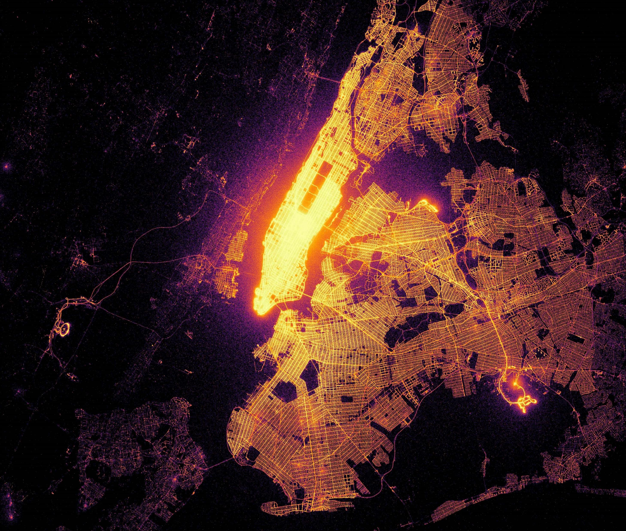
Drop-Offs

Slide 8
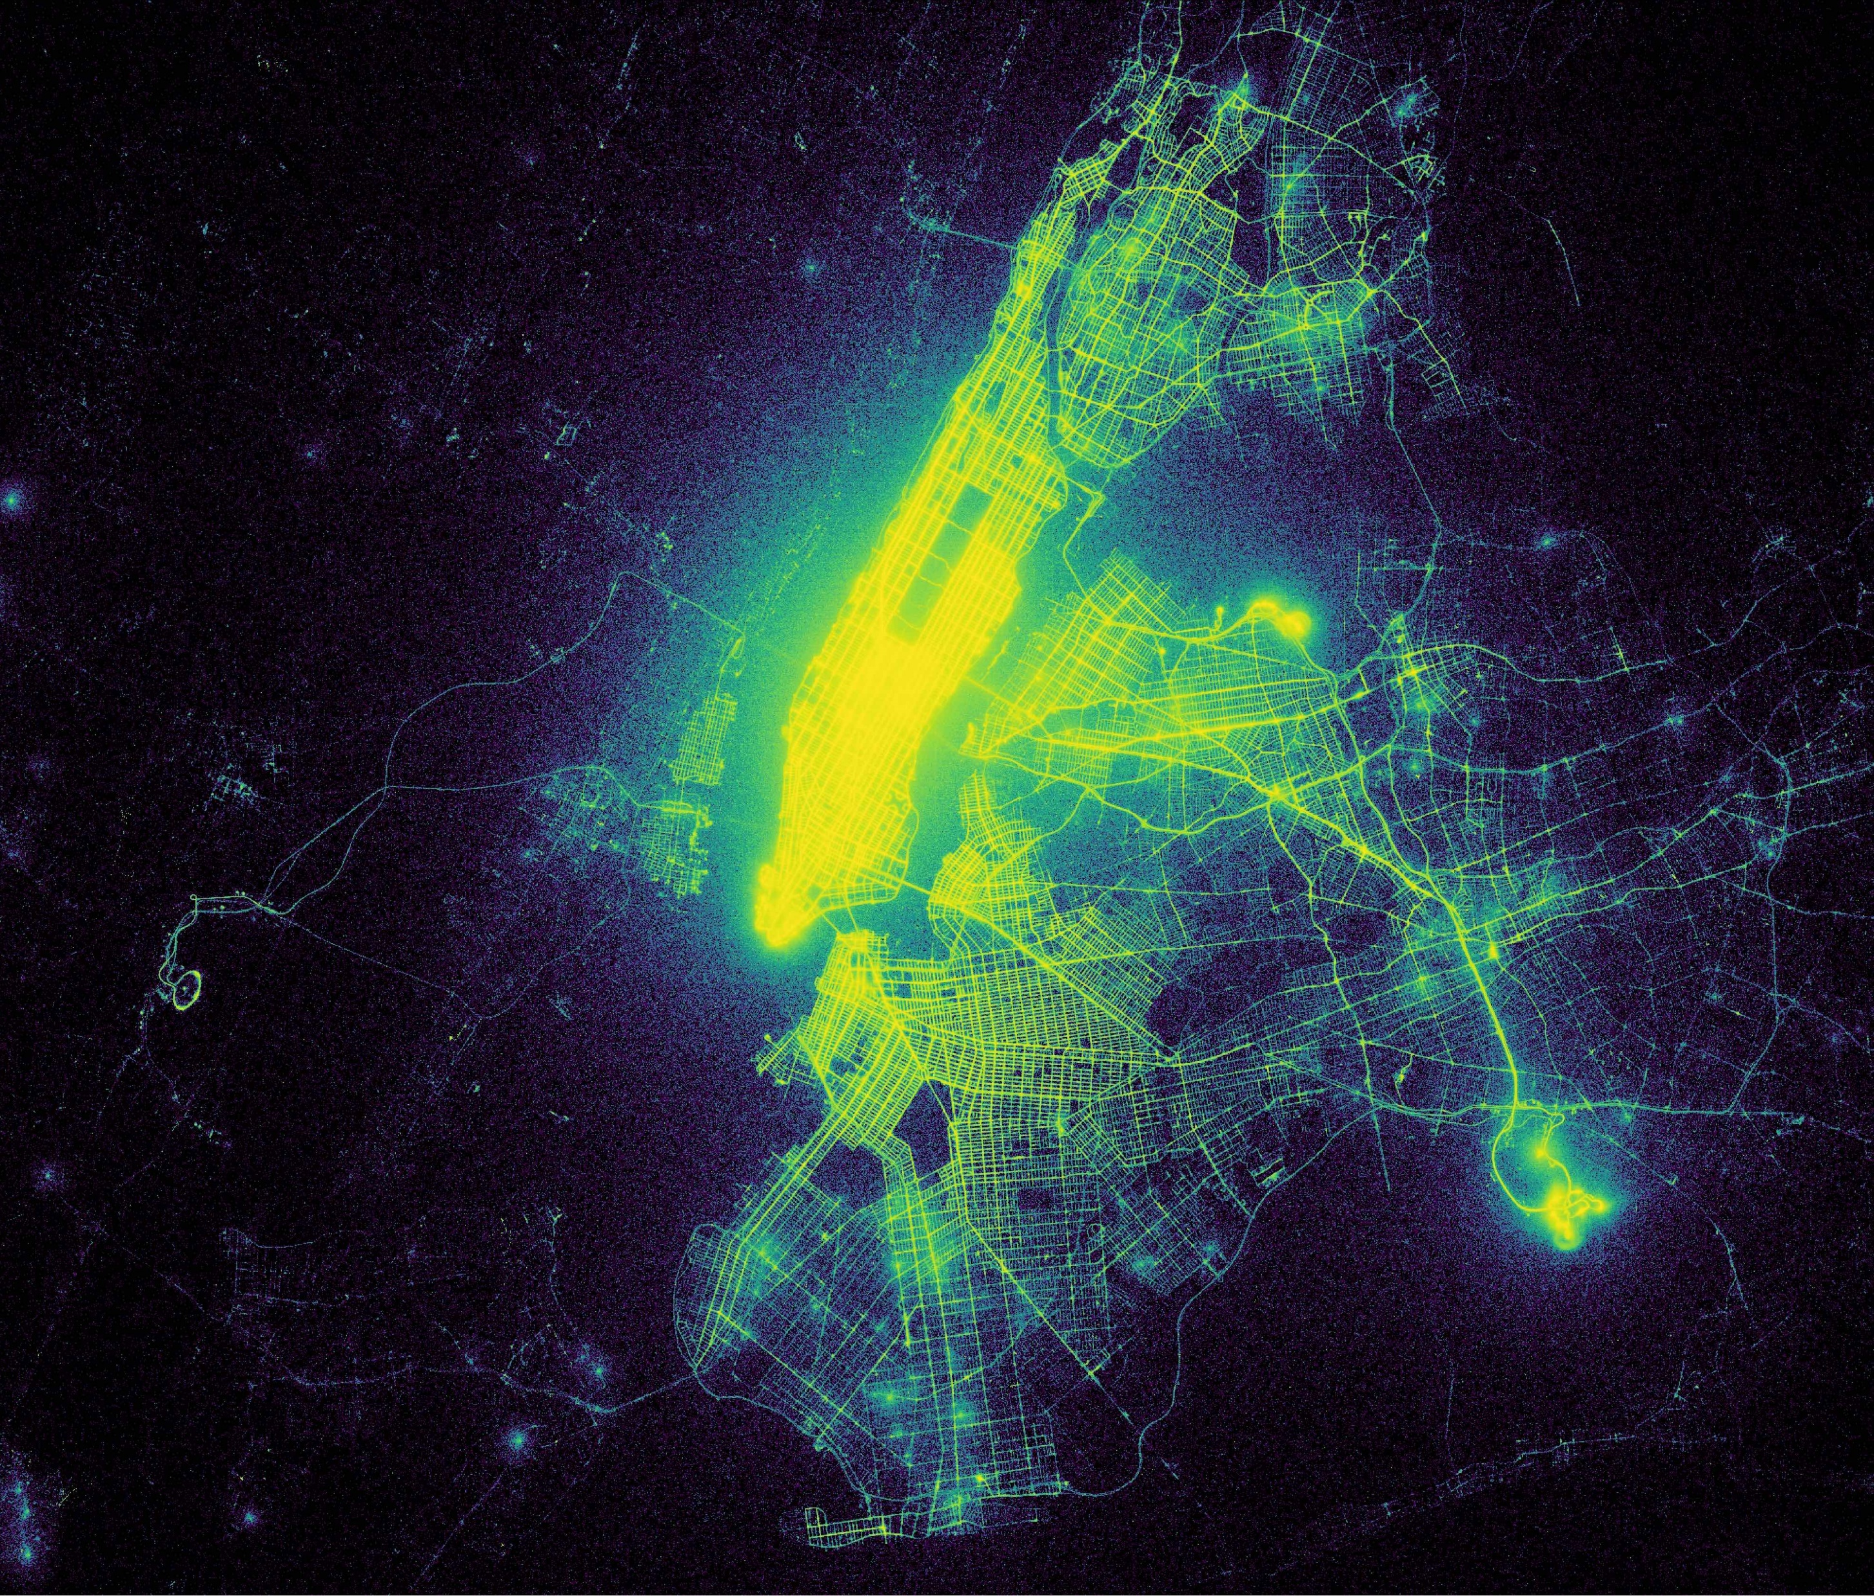
Pick-Ups

Slide 9
Thank You!
References:
https://github.com/r-shekhar/NYC-transport/blob/master/15_dataframe_analysis/Datashader_maps_01.ipynb

